Slide 1

Springfield Township
Trails & Connectivity Plan
Board of Commissioners Presentation
October 11, 2023
Brian J. Olszak
Principal Trails & Open Space Planner
Montgomery County Planning Commission

Slide 2
Goals of the Plan
Provide for the recreational needs of Township residents
Identify routes that maximize connectivity between key destinations, including parks, businesses and neighborhoods, in an equitable manner
Find routes that are safe, inviting, accessible and easy for users of all ages and abilities
Create list of clear, implementable projects for Township
Notes:
Safety, connectivity and walkability
Enhancing pedestrian safety by providing the public with more off-road opportunities to walk, run, and bike
Make it easier to travel to different parts of the Township without a vehicle

Slide 3
Plan Deliverables
Inventory of Existing Trails
Gap Analysis
List of Recommended Trail Improvements
Future Trails Map
Implementation Matrix

Slide 4

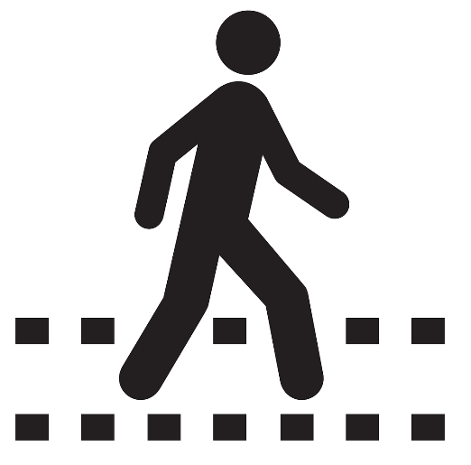

Inventory of Existing Conditions
Existing Pedestrian + Bicycle Network
Sidewalks, trails, greenways, bike lanes, low-stress streets, unofficial trails, crosswalks.
Environmental Features
Floodplains, water features, woodlands, preserved open space, steep slopes
Community Features
Schools, recreation center, parks, shopping centers, employment locations

Slide 5
Public Outreach
Trail Usage Survey
Sept – Oct 2022
Wikimap
Sept – Oct 2022
Public Meeting #1
Sept 29, 2022
High School Presentation
March 3, 2023
Middle School Presentation
March 2, 2023
728 respondents
49 individuals
54 individuals
31 students
21 students
Approx. 9% of households
Public Meeting #2
March 13, 2023
74 individuals
Notes:
Concurrently, we have undertaken several avenues of public outreach to understand the needs and desires of the Springfield community regarding walking, bicycling, and other methods of travelling that don’t involve cars.
Several key challenges, destinations, and uses came up repeatedly in comments from the Springfield community

Slide 6



Key Findings
Oreland and Wyndmoor
Residents cannot safely walk to other neighborhoods
Bethlehem Pike
Seen as the largest barrier by survey respondents
Cheltenham Avenue
Seen as the largest barrier by students

Slide 7
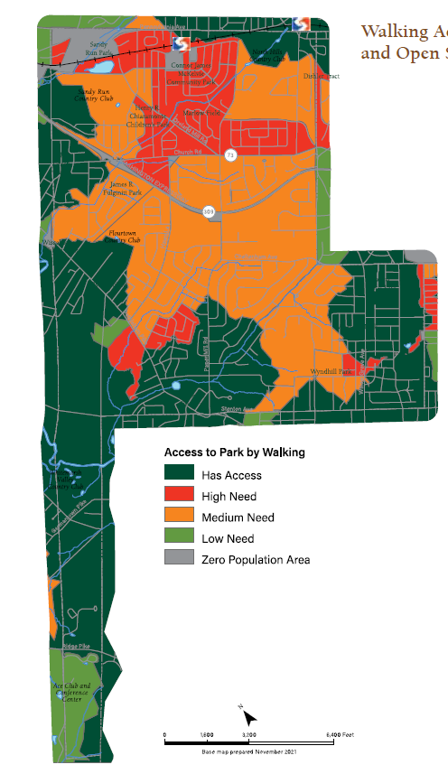
Access to Trails,
Parks & Open Space
Areas within 10-minute walk with pedestrian
facilities
High Need
Medium Need
Low Need
Has Access

Slide 8
Key Findings
Notes:
Through the survey, we heard most frequently that residents want to walk to a trail and that gaps in the pedestrian network or lack of nearby trails were the most commonly observed barriers to reaching trails

Slide 9

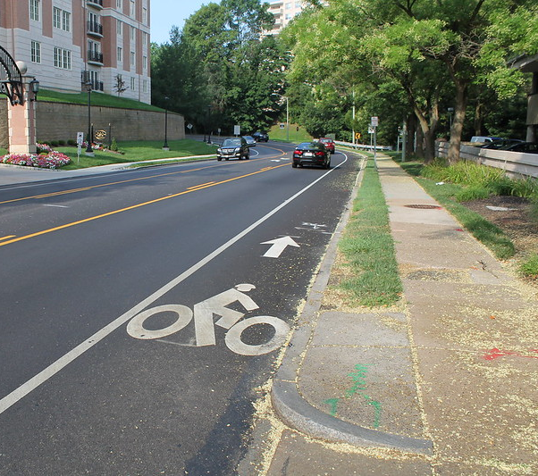
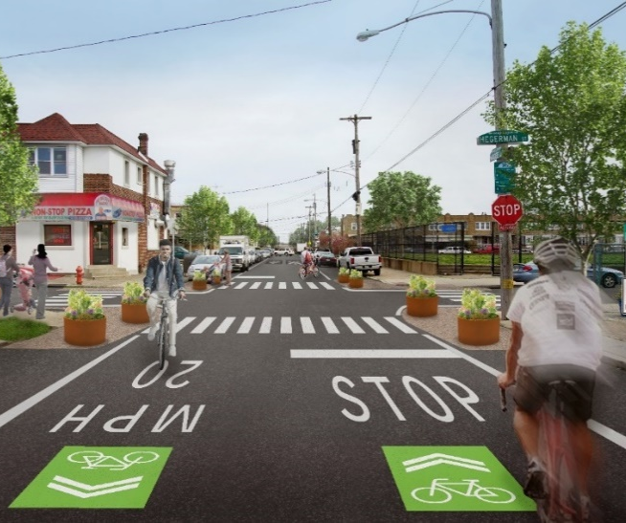
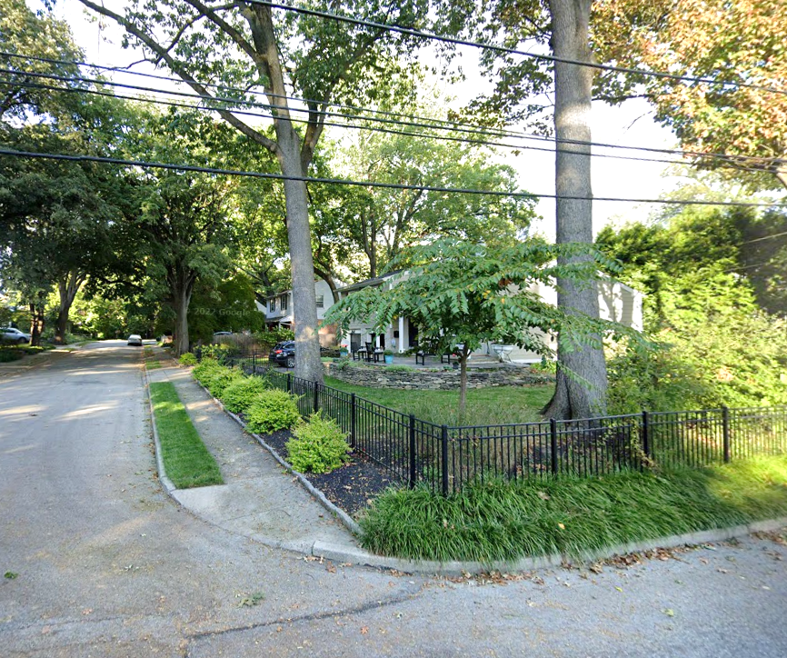
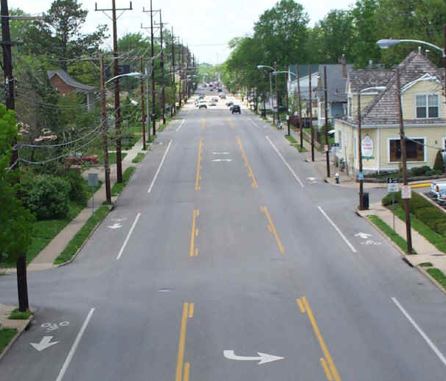
Proposed Facility Types
Priority Bike Route
Multi-Use Trail
Neighborhood Greenway
Sidewalk
Road Diet / Complete Street
Notes:
Multi-Use Trails
Image Source: https://greatruns.com/philadelphia-wissahikon-valley-parkforbidden-drive/
Wide enough for two bicycles to pass each other (usually 10 feet)
Paved or compacted gravel
Surrounded by a buffer of landscaping
May be surrounded by a fence to keep pedestrians on the trail
Priority Bike Route
Link low-stress roads for bicyclists across the county
Allow bicyclists access to long-distance on-road routes
Neighborhood Greenway
Streets that prioritize people walking, bicycling, and rolling
Connections between neighborhoods, parks, schools, and business districts
Neighborhood streets can become this through speed humps, raised crosswalks, curb extensions, wayginding signs
Sidewalk
* Image Source: Google Maps, Linden Road, Wyndmoor
Road Diet
Image Source: https://transportation.ky.gov/Congestion-Toolbox/Pages/Road-Diets.aspx
Involves converting a four lane roadway into a three lane roadway
These road diets improve traffic up to about 20,000 cars per day
Newly reclaimed space can be used for parking, bicycle lanes, installation of sidewalks, or widening existing sidewalks

Slide 10
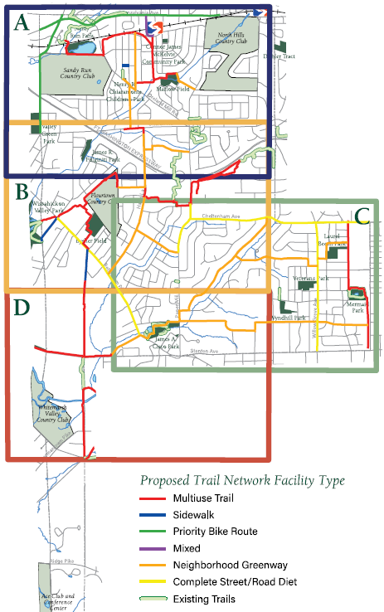
Proposed Network
By the numbers:
  28 New Proposed Trails & Routes
  25+ Miles of New Trails & Routes:
    9.76 mi of Multiuse Trails
    2.5 mi of Priority Bike Network
    7.98 mi of Neighborhood Greenways
    4.1 mi of Complete Streets + Road Diets

Slide 11
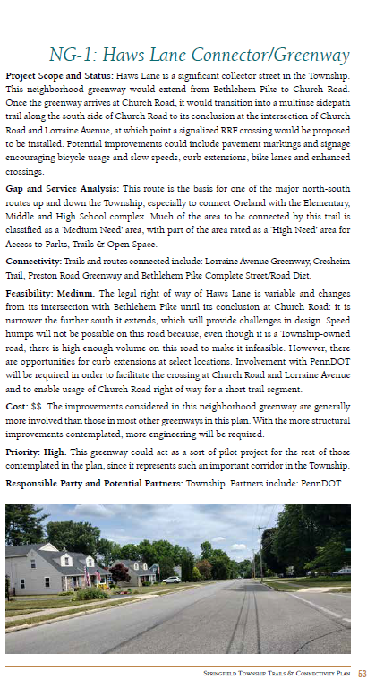
Segment Profiles
Project Scope and Status
Gap & Service Analysis
Connectivity
Feasibility Rating
Cost Rating
Priority Rating
Responsible Parties and Partnerships

Slide 12
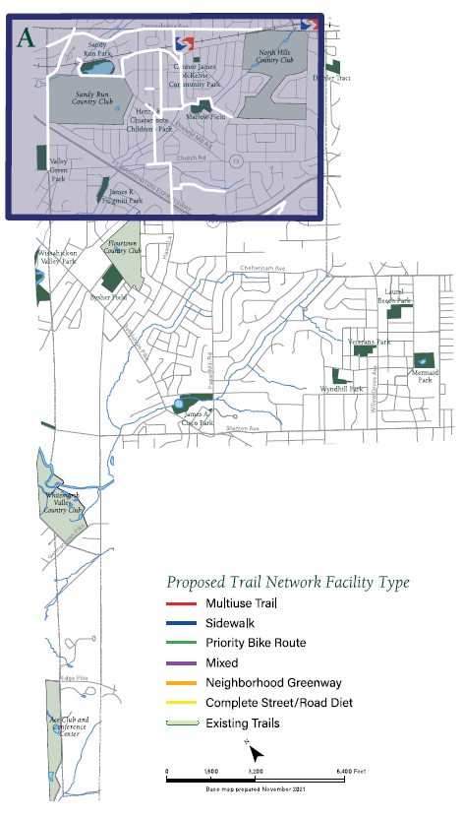
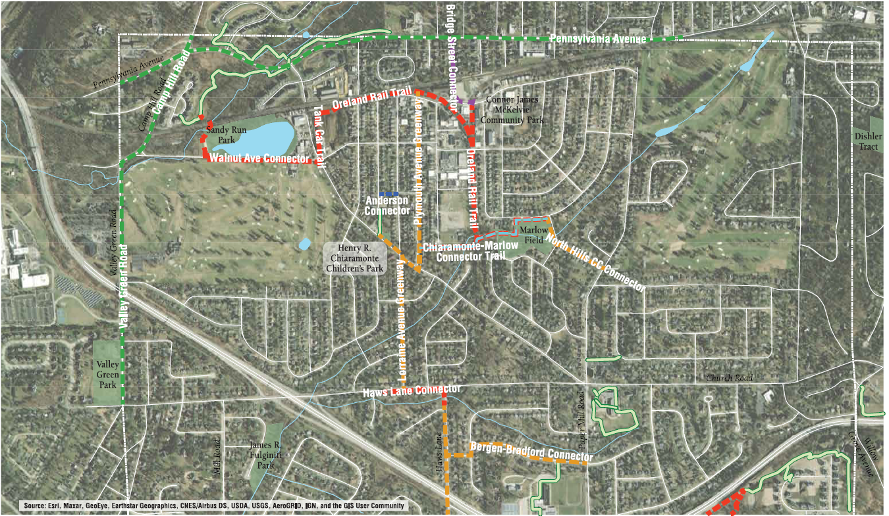
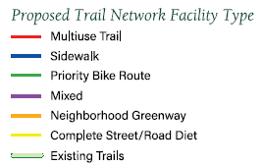
Section A

Slide 13
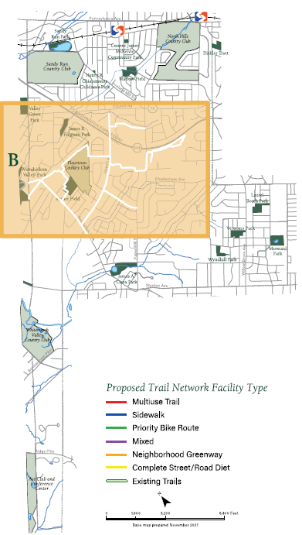
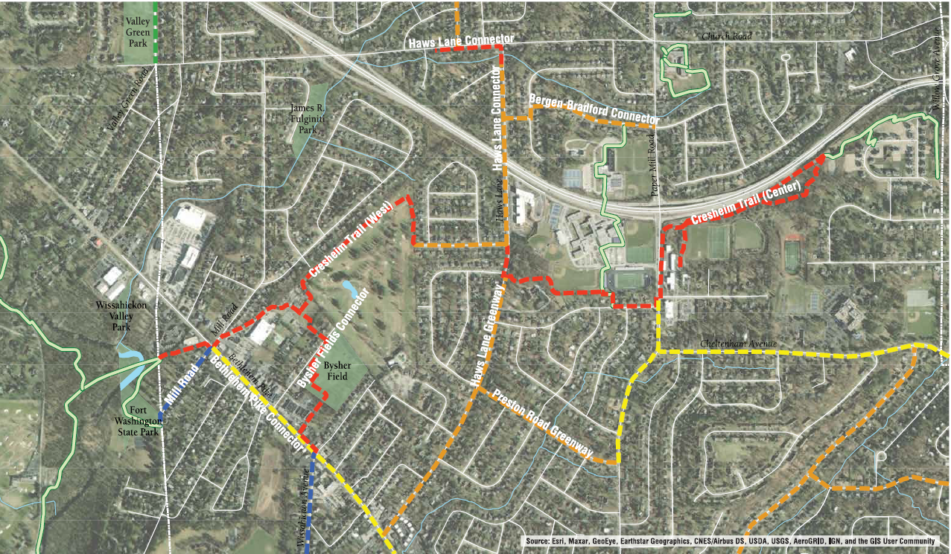
Section B

Slide 14
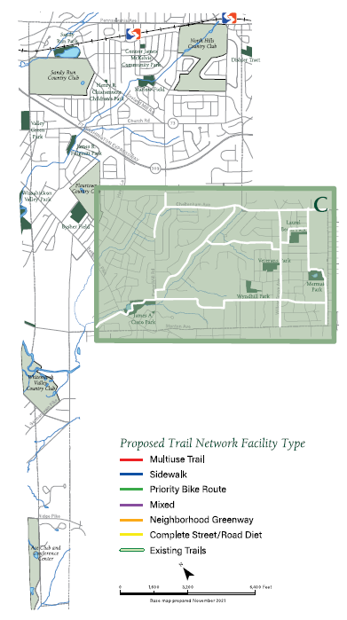
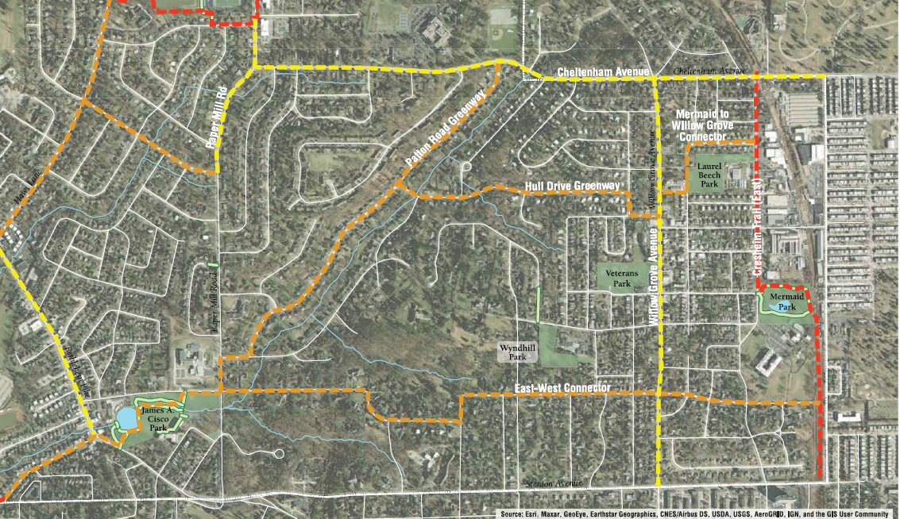
Section C

Slide 15
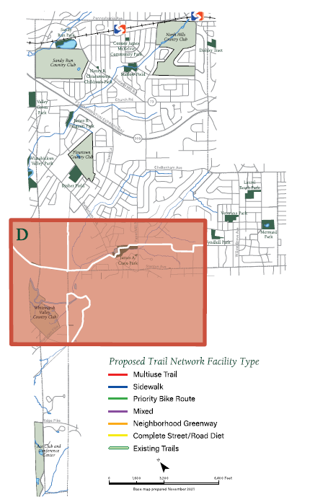
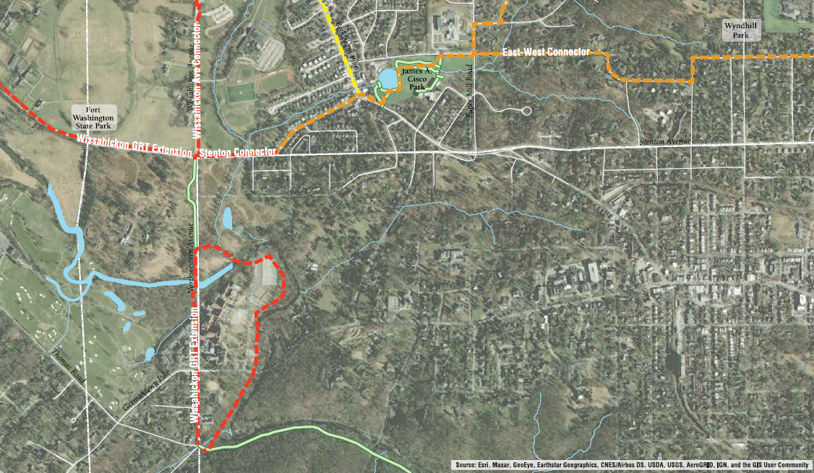
Section D

Slide 16
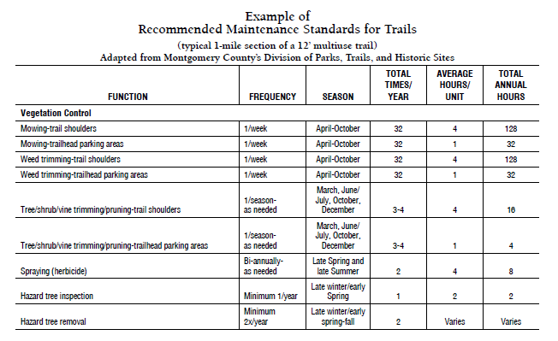
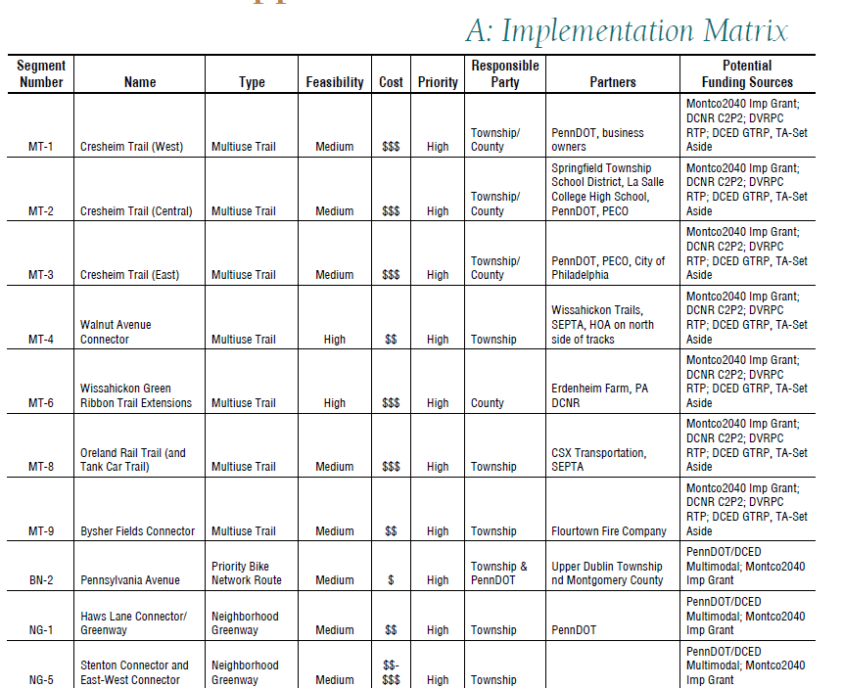
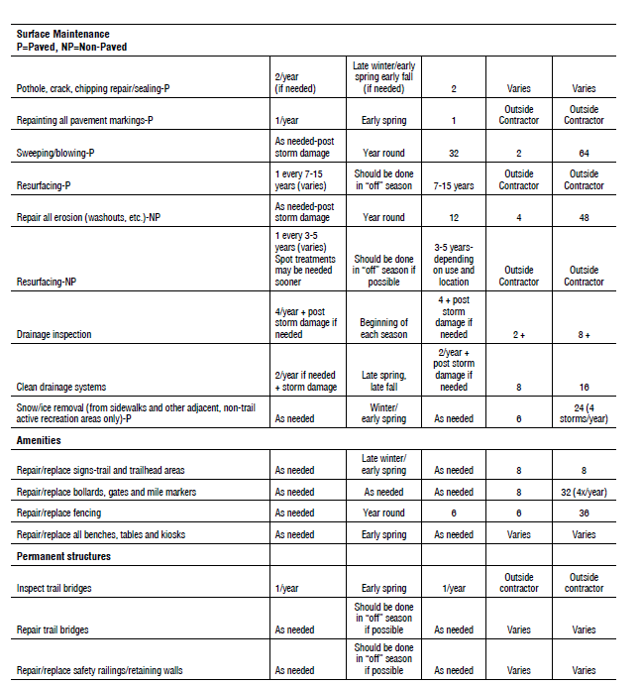
Additional Resources

Slide 17
Springfield Township
Trails & Connectivity Plan
Questions?
Brian J. Olszak
Principal Trails & Open Space Planner
Montgomery County Planning Commission

